Slide 1
Data quality, management and reporting
Respiratory Virus Genomics Workshop
10 September 2025
Jackie Kleynhans
National Institute for Communicable Diseases (NICD)
Johannesburg, South Africa
jackiel@nicd.ac.za

Slide 2
1
Consent to collect, store, process, disseminate
2
Collection tools
Data management
The process of collecting, organizing, storing and protecting information so that it can be analysed and results disseminated in a timely manner
3
Database architecture
4
Security
5
Quality checks
6
Analysis
7
Reporting

Slide 3
Consent
Considerations
Consent needed?
Consent provided?
Need to disclose how data will be stored and processed?
Data hosted locally/ internationally?
Can/will data be shared?
How long should data be stored?
Ethical clearance or waiver needed to collect samples and data from patients
Ethics waiver when part of legislature, e.g. mandated surveillance
Research outside this scope requires clearance and patient consent
Collection and consent framework subjected to country-specific laws on privacy and data protection
Collector’s responsibility to confirm that all requirements are met

Slide 4
Why?
Metadata needed to interpret results
What?
Only collect relevant information that will be used
Demographics: age, sex, location
How?
Paper-based or electronic
Self-completed or interview
Tracking trends over time
Risk factor analysis
Underlying conditions
Exposures
Store results
Metadata: data about data
Structured information (e.g. patient demographics, onset date, symptoms, collection date, primary testing results, etc.) that describes another piece of data (e.g. a full genome sequence)
Data Collection

Slide 5
Data collection tools
Paper-based
Electronic
Patient/requestor completes handwritten form
Captured to database
Simple for requestor
Requires printed forms
Resources needed to capture
Legibility can be problem
No validation
Time delay
Patient/requestor completes electronic form
Stored directly/exported to database
Real-time data validation
Real-time data availability
No additional resources to capture
Electronic device with internet connection needed

Slide 6

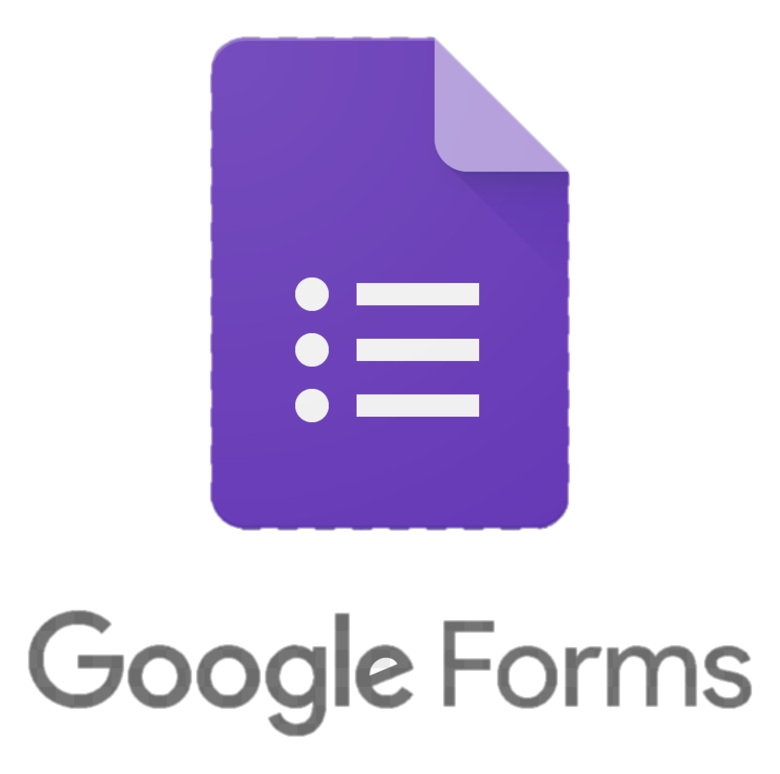



Electronic collection tool platforms
REDCap
Go.Data
ODK
SurveyCTO
Google Forms*
Survey Monkey*
Custom solutions
*Consider privacy policies

Slide 7
Advantages of compiling data into one consolidated database
Single source of truth: All data in one place makes reporting and monitoring easier
Improved data integrity: Reduces errors from duplication, versioning, or manual handling
Sustainability: Ensures long-term availability and consistency of data
Efficiency: Quicker and easier to extract data for analyses, reports (with potential for automation) , upload to public platforms (e.g. GISAID)
Traceability: Ability to link across datasets (e.g., from diagnostic testing to genomic results)
Sample selection: Rapid identification of records meeting criteria (e.g., positives below Ct threshold for sequencing)
Quality control: Easier to perform systematic checks across the full dataset
Security & access control: Centralized environment supports proper data governance

Slide 8

Database architecture
Platform
Design
Development
Implementation
Maintenance

Slide 9




Database architecture can be
As simple as…
…or as complex as

Slide 10
Examples of data points/fields
Not exhaustive!
Demographics | Laboratory | Sequencing**
Patient ID | Sample ID | Sequenced
Name | Sample type | Reason not sequenced
Surname | Collection date | Sequence result available
Facility | Collected by | Run ID
Province/state/region/district | Receipt date | Coverage
Date of birth/age | Receipt by | Depth
Sex | Tested (Y/N) | Lineage
Symptoms* | Reason not tested | Clade
Onset date | Individual pathogen results (including Pos/Neg and Ct)* | Subclade
Underlying conditions* | Sent for sequencing | File directory/path
Vaccination status* |  | Accession number (GISAID)
Vaccination date
* Separate fields
** For each pathogen

Slide 11

Considerations when selecting platform
Number of users
Simultaneous use?
Security requirements
Volume of data
Fields (questions)
Records (entries)
Relational* data requirements
Resources
Skills to build complex database
Skills to manipulate data
Cost of platform
*A relational database stores information in multiple tables, and data are combined by linking unique identifiers across tables.
For example:
Patient table (one line = one patient) links to sample table (one line = one sample).
One patient may have multiple samples

Slide 12

Using Excel as a database
Single version of database
Store file where everyone can access
Ensure no simultaneous updates are done
If needed, consider cloud-based workbook (Excel or Google Sheets)
Standardise fields (columns) and data formats
Provide detailed instructions for capturing
Build in validation tools
Password protect if any identifiers
Do not store the same type of data cross multiple sheets
Regular backups on multiple drives (dated)
Advanced functionality available to build queries: Power queries

Slide 13

Database security
Databases should be password-protected
Crucial if patient identifiers are captured
Database (and any back-ups) should be stored on secured drive
Back-ups are crucial to restore data in the event of:
Database corruption
Database loss (hard drive failure)
Data loss (deletion or incorrect updates to records)
Ransomware

Slide 14

Quality checks
Validation should be built-in as far as possible
Checks done routinely and regularly
Options to ensure data quality
Double data entry
Quality control of captured data
Beyond routine checks, more detailed checks should be done at less regular intervals
Manually in Excel
Standardised scripts in Stata/R/SAS/SPSS

Slide 15

Examples of validations and checks
No missing data for required fields
Sample collection date > Date of birth
Sample receiving date > Sample collection date
Result fields have specified options
Positive, Negative, Contaminated, Inconclusive
Numeric results fall in specified ranges
Lineage/clade corresponds to primary results

Slide 16


Data analysis
As simple as…
Or as complex as

Slide 17



Data analysis
Important to analyse data to keep track of
Quality
Results
This does not start with drawing trees!
At minimum, should consider
Number of samples submitted
Number of positives and detection rate
Consider including time (weekly/monthly) and areas
Lineage/clade detection by week
Can assist in
Monitoring trends
Planning resources

Slide 18
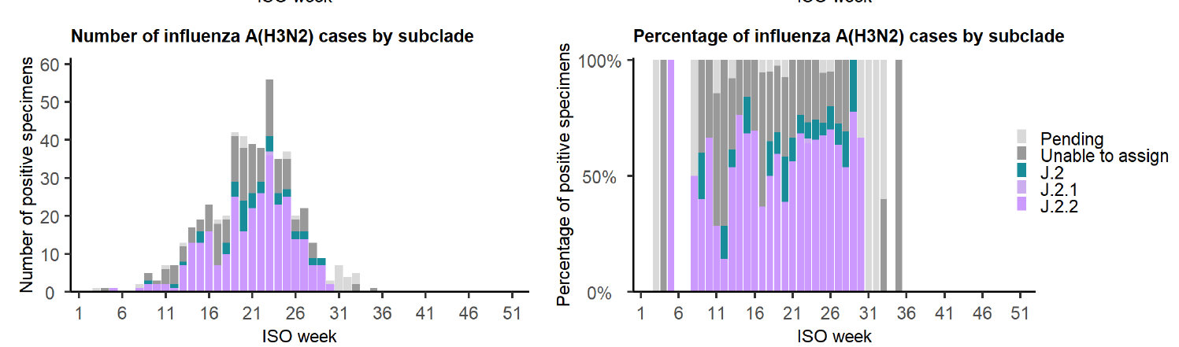
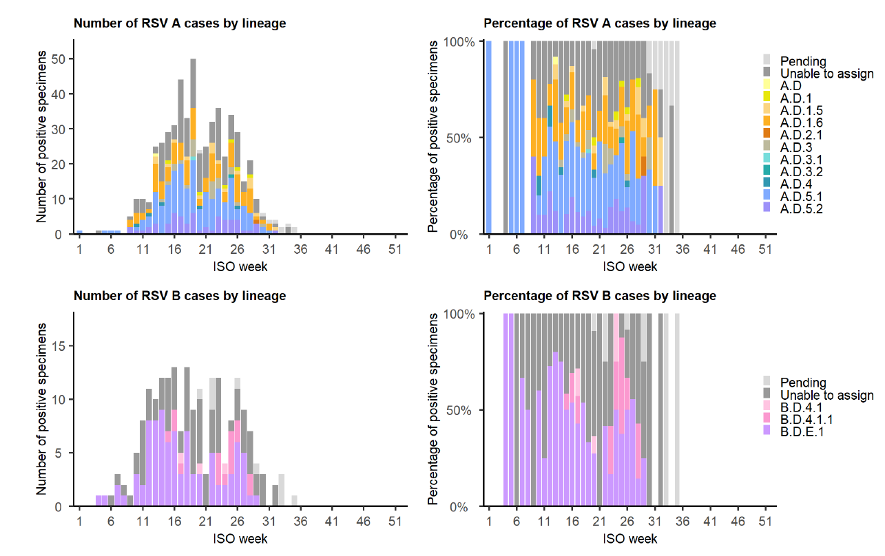
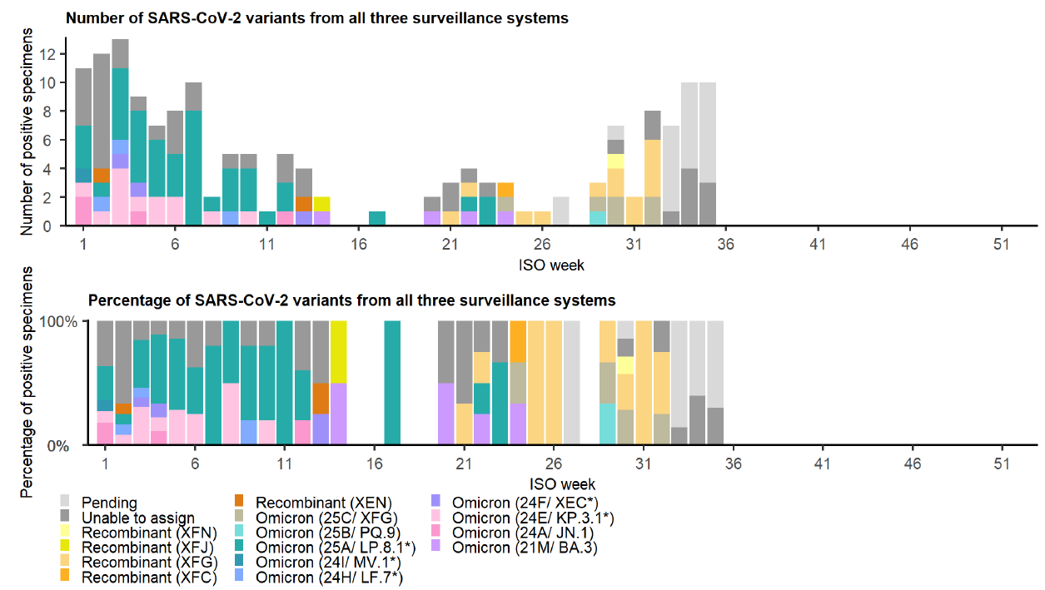
Combined number and percentage of influenza/RSV/SARS-CoV-2 cases by subclade/lineage/variant in all ages from three sentinel surveillance systems: outpatient influenza-like illness (ILI) surveillance in public primary health care clinics, outpatient ILI surveillance in private general practitioner practices, and inpatient pneumonia surveillance in public hospitals, South Africa, 30 December 2024 to 31 August 2025

Slide 19
Reporting
Data for action
Weekly/monthly/annual reports of trends
Publications in peer-review journals
Requires high quality, reliable data
Starts with good data management

Slide 20

Conclusion: Good data practise
Timely capturing of data directly to database
Real-time data validation
Timely data quality control and query resolution
Password control
Regular backup
Regular analysis
Standard operating procedures
Up-to-date data dictionary

Slide 21


Slide 22
